Slide 1


AI-Powered Medical Doctor Category Recommendation System
Team 8 AI Mavericks

Slide 2



Introduction
Title: AI-Powered Medical Doctor Category Recommendation System
Objective: To assist visitor to find the appropriate medical doctor based on the one’s biodata, medical records, symptoms, and preference.
Features:
Visitor‘s biodata consideration (gender, age, and smoking status, MD records, et cetera.)
Multiple turns conversation to interactively collect visitor’s symptoms;
Decide MD category, and provide the explanation of the decision;
Appointment scheduling and confirmation capabilities given visitor‘s preference (address and time).

Slide 3
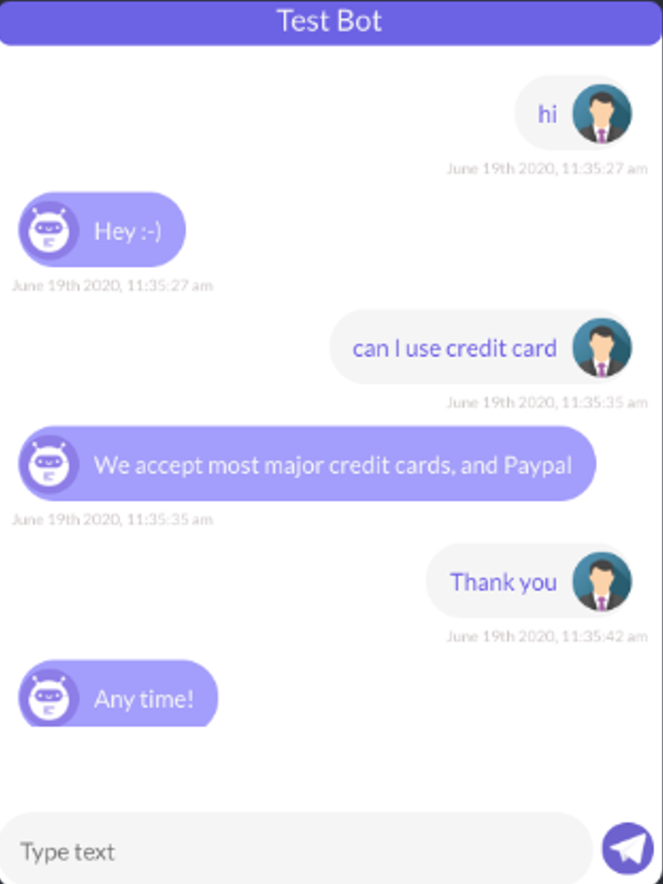
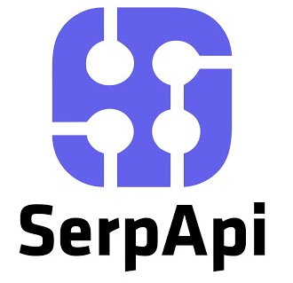
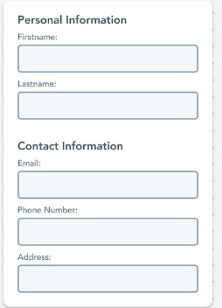







Overall System Diagram
Chat GUI
MD category
Visitor’s address
User response
Flow and rule-based logic
Ask questions
Predefined questions
A list of clinics
in this category with address
DB
ID
Symptom desc
MD records
Selected doctor
Determine MD category
Available time for this Dr
BioData
Initial form
openai.ChatCompletion
sender_email
smtp_server
smtp_port
receiver_email

Slide 4
Flow chart of the Chat-bot
Submit form
greeting
Turn by turn conversation
found category?
N
Y
appointment?
N
End
Y
Select recommended MD
Select time slot
Confirmation email
End

Slide 5
In-Context Learning and System Role
In-Context Learning with Pretrained Knowledge:
The AI-agent employs in-context learning, utilizing the system role‘s context alongside its pretrained knowledge as common sense for informed decision-making.
System Role: Context and Data:
The system role holds patient biodata, and Medical records, and MD classification logic

Slide 7
Overall system diagram
End to end system diagram, LLM, category, classification, competition--- show LLM integration,
GUI feature, background, gmap, overall diagram, system,
Live demo: recorded video, show UI, click interaction, 6 pages,
Appendix: reference;
Present: 15 min, introduction, feature, overall diagram.

Slide 8
Form-Based Visitor Information Collection
The visitor is prompted to fill out a form providing the following information:
0. Name
Gender
Age
Smoking Status (Yes/No)
Medical History/Records
Address
Contact Details

Slide 9
Greeting and Initial Conversation
Visitor Interaction Initiation:
The AI agent initiates the engagement by extending a cordial greeting to the visitor.
It also acknowledges the successful submission of the form by the visitor.
Inquiry for Visitor's Purpose:
The AI agent proceeds with an open-ended query: "What brings you here today? How can I assist you?"
This question prompts the visitor to share the reason for their interaction and the specific assistance they require.

Slide 10
Turn-by-Turn Conversation
Conversational Exchange:
The interaction unfolds as a dynamic turn-by-turn dialogue between the AI-agent and the user.
In-Context Learning and System Role:
The AI-agent employs in-context learning, drawing insights from the System Role which encapsulates the recommendation logic.
This contextual knowledge enriches the conversation with tailored recommendations.
Leveraging Pretrained Knowledge:
Simultaneously, the AI-agent taps into its extensive pretrained knowledge base.
This vast repository enables the AI to provide responses that are well-informed, comprehensive, and accurate.

Slide 11
AI-Powered Recommendation Process
Visitor Information Processing:
The AI agent systematically processes a range of visitor information, which encompasses biodata, reported symptoms, and available medical records.
Matching with OpenAI Language Model (LLM):
Employing OpenAI's Language Model (LLM), the AI agent undertakes the task of aligning the individual's details with the most fitting medical doctor category.
This process involves analyzing and comparing various factors to determine the optimal match.
Explanatory Recommendation:
Subsequent to the matching process, the AI agent proceeds to elucidate the basis for its recommendation.
The explanation is grounded in the amalgamation of the collected data, underscoring how the individual's information aligns with the suggested medical doctor category.

Slide 12
Brief description for the AI-Assistant
Foundation on OpenAI Chat Completion:
The framework is established upon OpenAI's Chat completion model.
The Engine is gpt-3.5-turbo-16k, which can handle 16k tokens, and output token is 256;
Inclusion of in-context learning capability, wherein the context involves the logic for recommending the Medical Doctor (MD) category.
The AI retains this contextual knowledge but also leverages its pre-existing extensive knowledge for informed decision-making.
Role Allocation:
Two roles are defined: System Role and Patient Role.
The System Role encompasses the recommendation logic for MD categories as well as the patient's biodata.
Conversational Dynamics:
The conversation unfolds in a turn-by-turn manner between the AI-agent and the user.
The AI-agent utilizes the context from the System Role for reference while interacting.

Slide 13
Appointment Scheduling
Address Conversion:
The provided visitor address is processed to derive its corresponding longitude and latitude coordinates through geolocator services.
Doctor Search:
SerpAPI is engaged to conduct a comprehensive search for nearby doctors within the recommended medical category endorsed by the AI.
Appointment Inquiry:
The AI agent initiates a query to the visitor: "Would you like to schedule an appointment with the suggested doctor?"
Confirmation and Scheduling:
In the event of visitor agreement, the AI agent efficiently arranges the appointment with the recommended doctor.
Visitor's preferred date and time selections from the calendar are accommodated in the scheduling process.

Slide 14
Confirmation Email
Swift Confirmation Email:
Once the appointment is successfully scheduled, the AI agent promptly sends a confirmation email to the visitor's designated address.
Comprehensive Appointment Details:
The email includes essential appointment information such as the date, time, and location of the appointment.
Summary of Medical Doctor Category:
The email also provides a succinct overview of the recommended medical doctor category, ensuring a clear understanding for the visitor.

Slide 15
Web App Deployment Overview
Dockerize Web App: - Base Image: python:3.9-alpine - Packaged the app for a lightweight, efficient deployment
Kubernetes Deployment: - Utilized Kubernetes (K8s) for orchestration - Deployed the Docker image in a K8s deployment - Service setup for port-forwarding, ensuring accessibility
Environment Management: - Used K8s secrets - Mounted environment variables securely

Slide 16
Deploying our app in the cloud env (aws)
Cloud Hosting (Amazon EKS): - Region Selection: Deploy our app in a region close to our primary user base to reduce latency. - High Availability: Deploy across multiple availability zones.
User Protocol (HTTPS): - Use AWS Certificate Manager (ACM) to generate an SSL certificate. - Implement AWS ALB (Application Load Balancer) Ingress Controller in EKS, which automatically uses the ACM certificate for HTTPS. - Ensure redirects from HTTP to HTTPS.
Scalability: - Horizontal Pod Scaling: use Horizontal Pod Autoscaler (HPA) to scale the number of pod replicas based on observed CPU utilization or other select metrics. - Horizontal Node Scaling: Use the Cluster Autoscaler. It will automatically adjust the number of nodes as needed.

Slide 17
Deploying our app in the cloud env (aws)
Security: - IAM Roles: Assign minimal necessary AWS permissions using IAM roles. Integrate IAM with Kubernetes RBAC. - Secrets: Use AWS Secrets Manager or KMS (Key Management Service) for storing secrets. Integrate with Kubernetes using tools like external-secrets. - Patch Management: Regularly update and patch your containers and nodes. Consider using tools like kube-bench for security benchmarking.
Server-Side Node (Node Configuration): - Node Groups: Use different node groups for different types of workloads (e.g., CPU-intensive, memory-intensive). - Node Affinity: Ensure specific pods run on specific types of nodes. - Taints and Tolerations: Prevent certain pods from running on certain nodes.
User Visitor Increase: - Monitor: Use tools like Amazon CloudWatch and Prometheus to monitor cluster, node, and pod performance. - Alert: Set up alerts for high CPU, memory usage, or increased error rates. - Caching: Use caching mechanisms (e.g., Amazon ElastiCache) to alleviate database load and reduce response times.

Slide 18
Conclusion
Seamless and Personalized Assistance:
The AI-Powered Medical Doctor Category Recommendation System introduces a streamlined and personalized method for visitors to discover suitable medical doctors.
In-Context Learning for Tailored Recommendations:
Harnessing in-context learning, the system delivers recommendations that align with the user's context, ensuring relevance and precision.
Effortless Appointment Booking and Enhanced Experience:
The system simplifies the appointment booking process, offering convenience and efficiency.
Overall, this system contributes to an elevated healthcare experience, benefiting both visitors and medical professionals.

Slide 19
Future works
Suggestions

